Slide 1

Diabetes Classification
Abrar Alsharidi
Morooj Aldeeb
This Photo by Unknown Author is licensed under CC BY

Slide 2

Contents
INTRODUCTION
METHODOLOGY
TOOLS
EDA
PREPROCESSING
MODELLING
FEUTURE WORK

Slide 3
Introduction
In this project and according to the data set, we will use supervised machine learning techniques. Particularly, binary classification to predict the outcome of a diabetic patient based on set of features which are thought to be very important, and which are likely able to explain the variability in disease outcome in different patients

Slide 4
objective
predict the diabetes degree based on the health condition of the patient and the frequency of patient visits to hospitals

Slide 5




METHODOLOGY
EDA
Preprocessing
Baseline Model
Feature engineering .
Test the Best Model
Model Deployment

Slide 6
MetaData
The data source used was the UCI website, it represents 10 years (1999-2008) of clinical care at 130 US hospitals.
Data frame shape:-
Original data:101766 observations and 50 columns
After EDA: 99340 observations and 40 columns
After Feature engineering: 99340 observations and 37 columns

Slide 7

Tools and Libraries
Tools: Jupyter notebook , Python
libraries: Pandas ,NumPy ,Matplotlib. ,Seaborn, Scikit-learn

Slide 8
EDA
MISSING VALUES
-Dropping null columns
Categorical Values
- get dummies
- Label Encoder
(metformin)
Dropping Unneeded Column
Creating New Columns
- readmit & diabetes

Slide 9
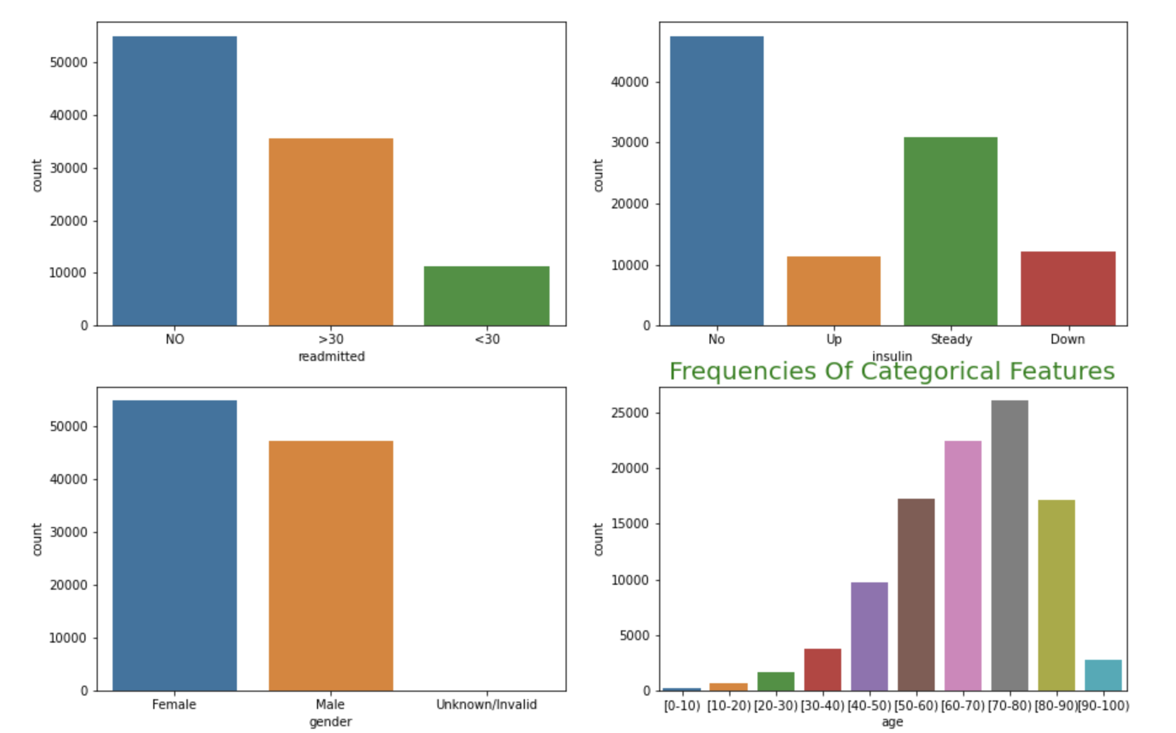
Data Understanding
Viewing the variables in the dataset to understand the dataset better

Slide 10
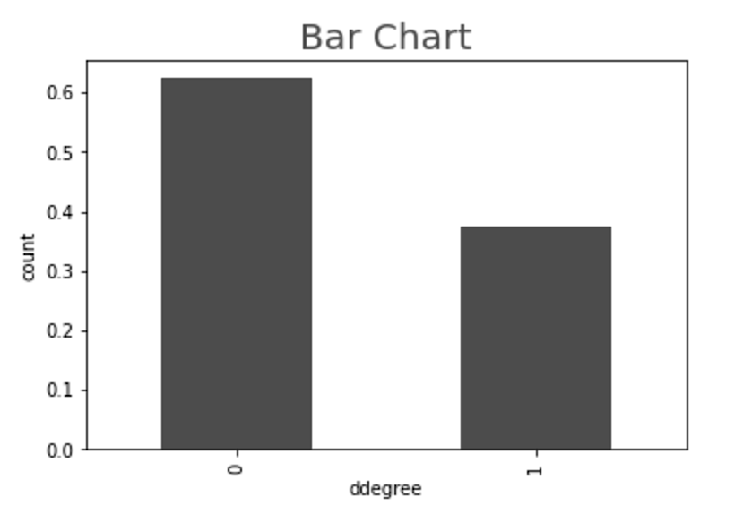
Diabetes Degree
Here it is clear that the data is nearly balanced

Slide 11
Classification Modelslassification Modelling
We split our data into: training set: 80%, Validation 10% and Testing 10%
Model Name | Training Score | Validation Score
K-nearest Neighbors | 0.82 | 0.66
Logistic Regression | 0.66 | 0.43
Decision Tree | 0.66 | 0.53
Random Forest | 0.99 | 0.69
XGBoost Classifier | 0.71 | 0.70
Bernoulli | 0.66 | 0.66
AdaBoost | 0.67 | 0.67

Slide 12
FEATURE ENGINEERING
We converted Readmitted from Nominal into binary by encoding No=0 and others=1. while DiabetesMed was encoded as yes=1 and no=0 and created a completely new column called ‘ddegree’ using Logic AND between Readmitted and DiabetesMed.
We used Standard Scaler (Z-score).
We used the top 10 most influential features.

Slide 13
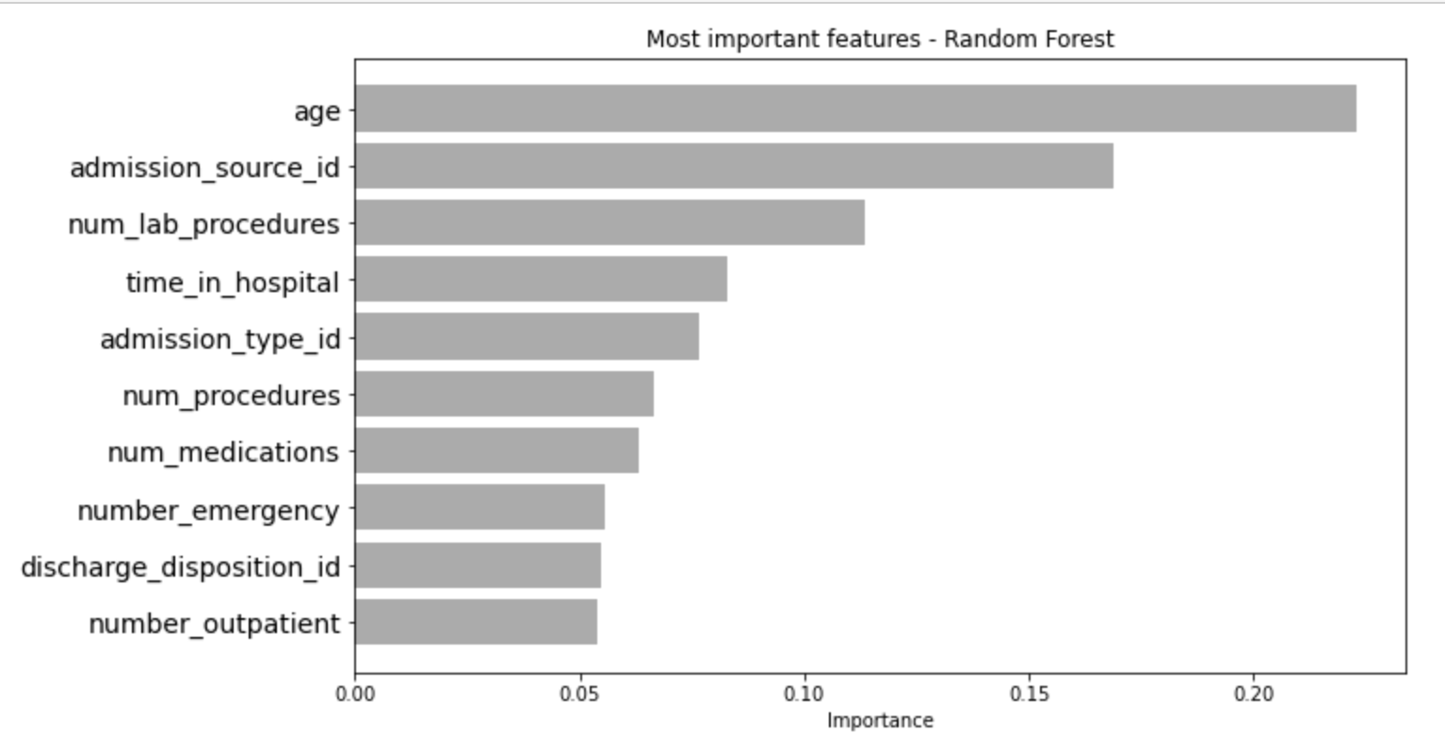
Best 10 Featureseature engeneering
Find the most important columns with our target and remove the other.

Slide 14
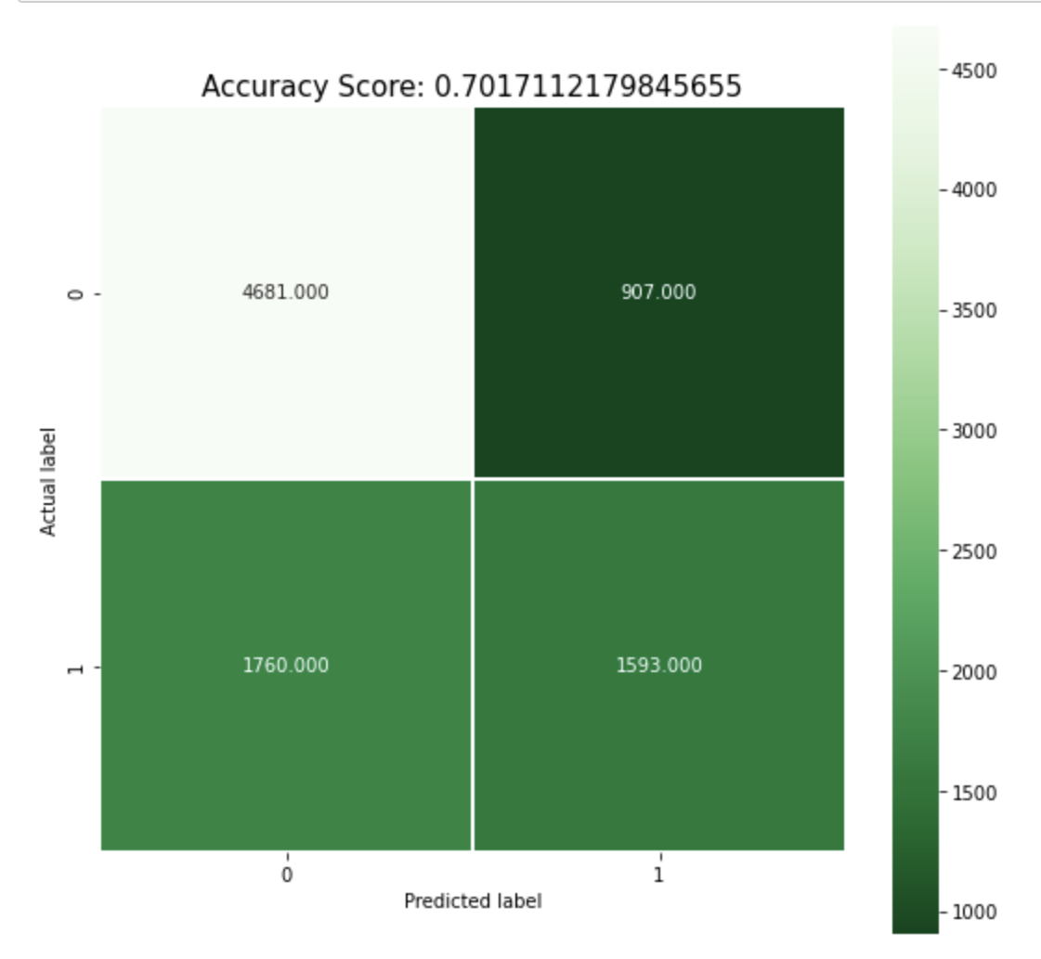
(confusion matrix) XGBoost Classifier

Slide 15
Hyper-parameters
The best model tested so far is XG Boost followed by Random Forrest.
n_estimators=30000, max_depth=4, objective='binary:logistic', learning_rate=.05, subsample=.8, min_child_weight=3, colsample_bytree=.8

Slide 16

Classification Models
Tunned Models | Accuracy | Recall | Precision | F1 Score
K-nearest Neighbors | 0.65 | 0.66 | 0.65 | 0.66
Logistic Regression | 0.66 | 0.34 | 0.59 | 0.43
Decision Tree | 0.66 | 0.50 | 0.56 | 0.53
Random Forest | 0.69 | 0.53 | 0.59 | 0.56
XGBoost Classifier | 0.70 | 0.47 | 0.63 | 0.54
Naive Bayes |  |  |  | 0.66
AdaBoost |  |  |  | 0.67

Slide 17
XGBoost Classifier
Dataset | Accuracy | F1 Score
Testing | 0.70 | 54

Slide 18
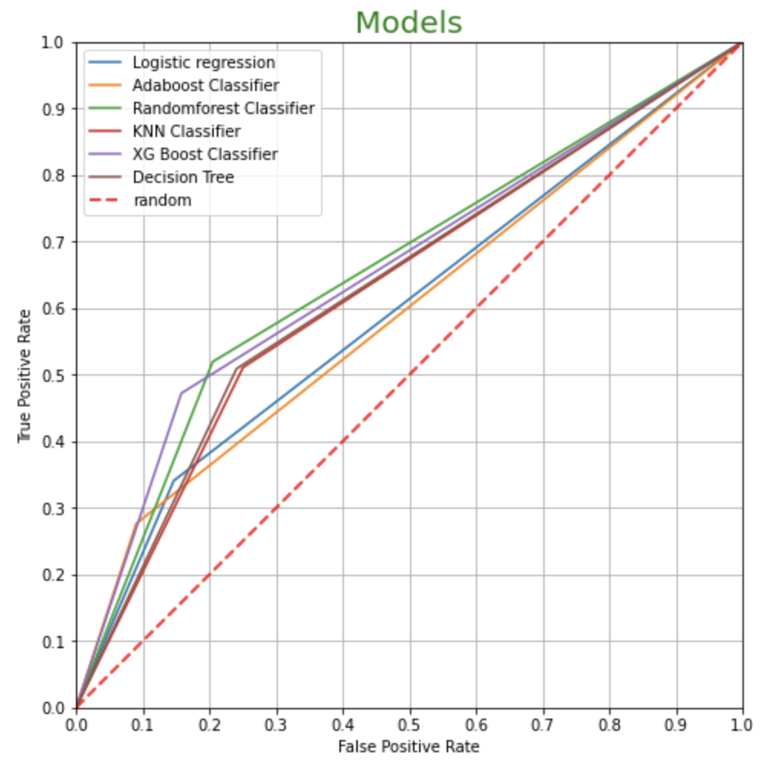
Models( ROC Curve)
Explains the best two models in terms of accuracy (XG boost) and Random Forrest Classifiers

Slide 19

Future work
Applying more complex models to classify diabetic patients perhaps with better results. i.e., Deep Learning (Neural networks) models.
This Photo by Unknown Author is licensed under CC BY-NC

Slide 20
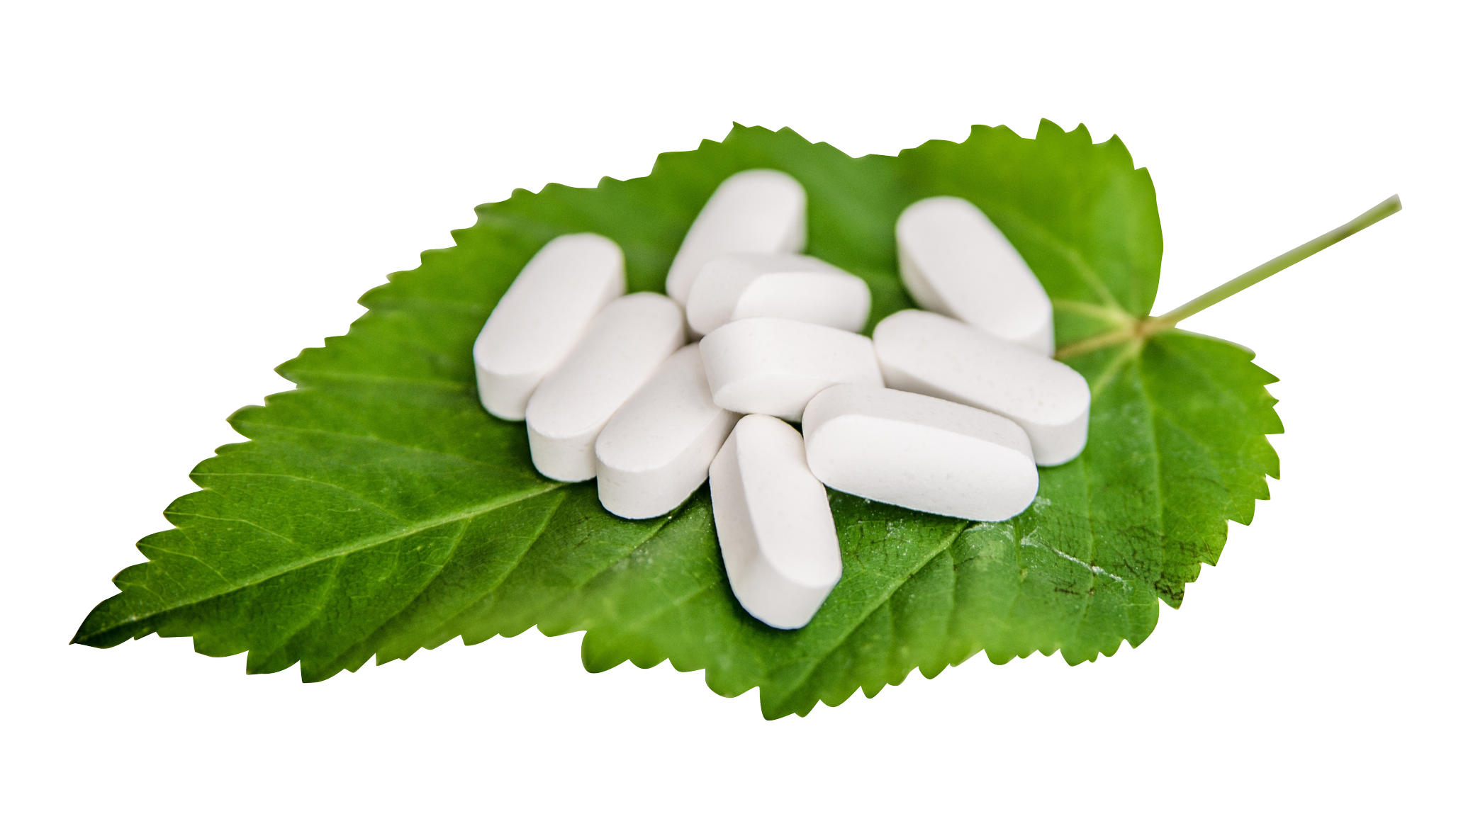
Thank you for listen ☺

